Slide 1

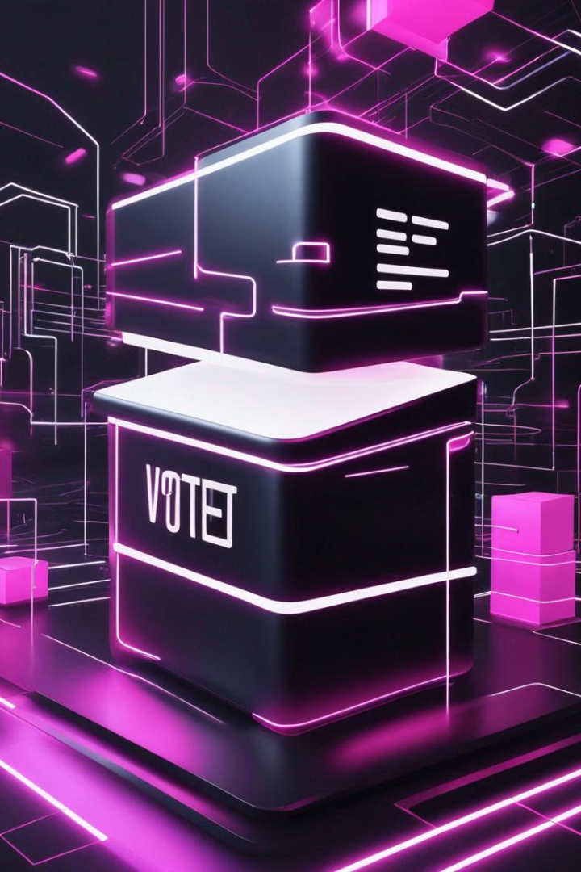

Decentralized Voting System using Blockchain
Enhancing Trust and Transparency in Elections
Blockchain technology offers a transformative solution for enhancing trust and transparency in the electoral process. By leveraging the decentralized, immutable, and transparent nature of blockchain, this system aims to revolutionize the way we approach voting and strengthen the integrity of democratic elections.

Slide 2


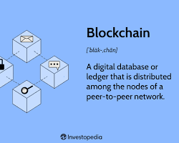
Project report in partial fulfilment of the requirement for the award of the degree of Bachelor of Technology in CSE(IOT,BCT,CYS)
Pinaki Pritam Singha University Roll No. 12021002029065 Trideep Saha University Roll No. 12021002029040 Ratul Das University Roll No. 12021002029046
Kuntaleeka Kundu University Roll No. 12021002029016 Tathagata Ghosh University Roll No. 12021002029039 Suchak Sarkar University Roll No. 12021002029071
Yagnasree Chakraborty University Roll No. 12021002029062 Aniket Marik University Roll No. 12021002001073 Nilarghya Nandan University Roll No. 12021002029036 Sayan Maity University Roll No. 12021002029198
Under the guidance of
Prof. Dr. Siddartha Roy
Department of CSE(IOT,BCT,CYS)

Slide 3

ACKNOWLEDGEMENT
We would like to take this opportunity to thank everyone whose cooperation and encouragement throughout the ongoing course of this project remains invaluable to us.
We are sincerely grateful to our guide Prof. Dr. Siddartha of the Department of CSE (IOT, BCT, CYS), UEM, Kolkata, for his wisdom, guidance and inspiration that helped us to go through with this project and take it to where it stands now.
Last but not the least, we would like to extend our warm regards to our families and peers who have kept supporting us and always had faith in our work.

Slide 4
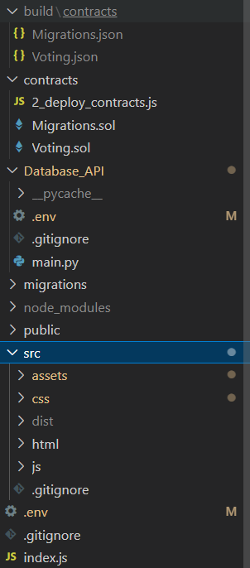
Experimental Setup and Result Analysis:
Requirements:
• NodeJS
• Truffle
• Ganache
• Solidity
• Metamask
• Python
• FastAPI
• MySQL
• HTML-CSS

Slide 5
Experimental Setup and Result Analysis:
truffle console > compile
Browserify
Node index.js
API CALL > UVICORN
Truffle migrate

Slide 6
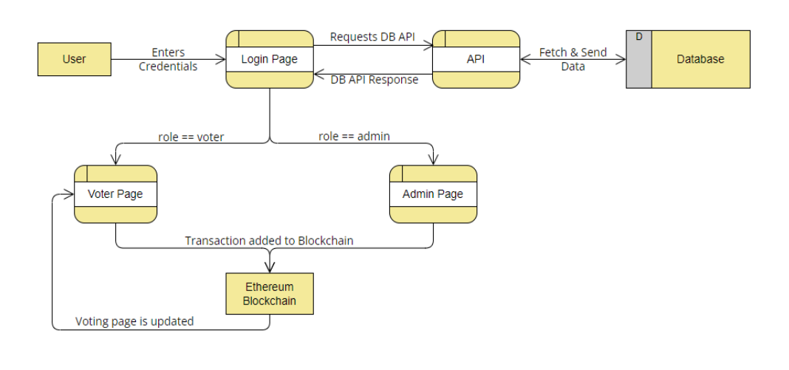
Experimental Setup and Result Analysis:

Slide 7
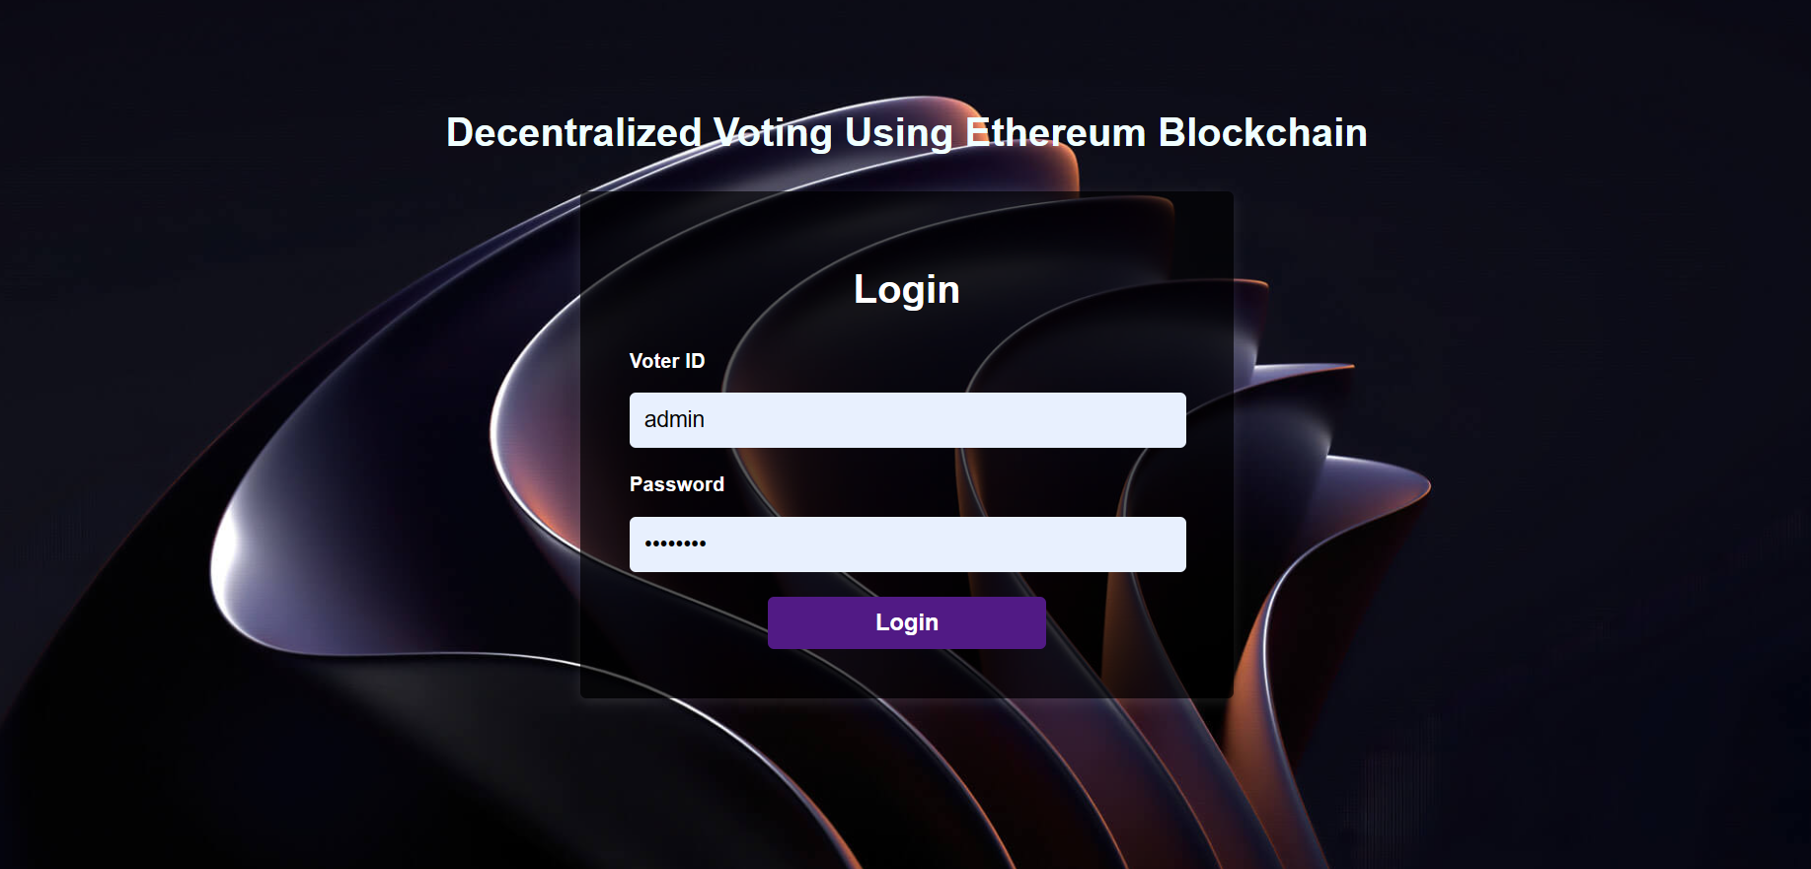
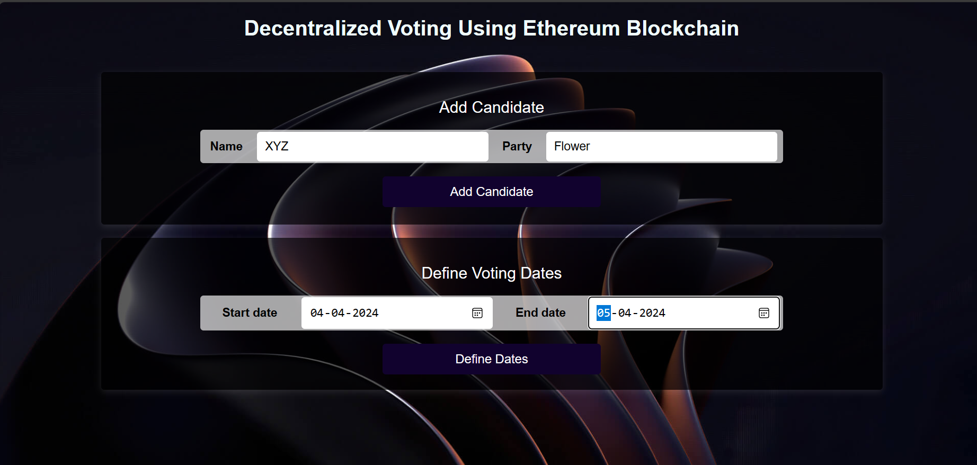
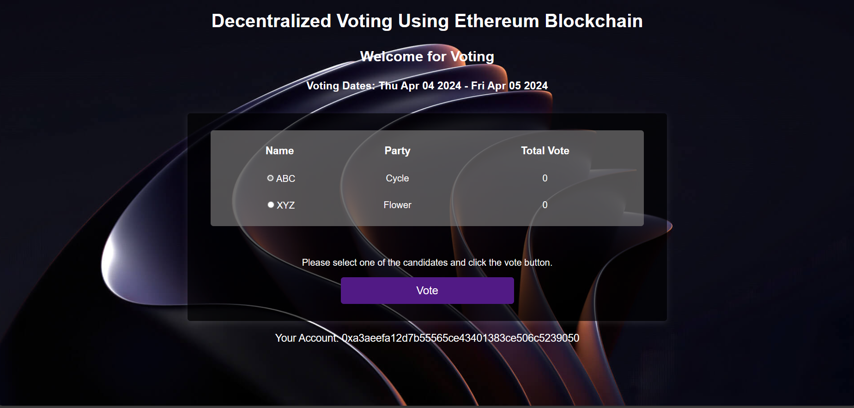
Experimental Setup and Result Analysis:

Slide 8
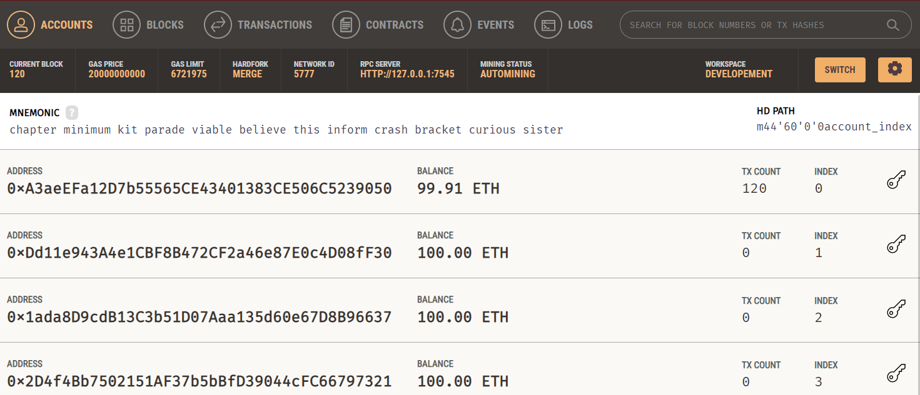
Experimental Setup and Result Analysis:

Slide 9


CONCLUSION & FUTURE SCOPE
Utilizing Ethereum Blockchain, decentralized voting presents a robust and transparent solution for ensuring secure elections. Through blockchain technology, it guarantees the integrity of votes and establishes a tamper-proof platform. With ongoing improvements, including enhancing user experience, scalability, and integration with other innovative technologies, decentralized voting holds the potential to transform the democratic process. It empowers citizens to engage in a reliable and efficient voting system, marking a significant stride toward fostering a more democratic and accountable society.
Future Scope:
Future iterations of the decentralized voting system could incorporate additional features, such as real-time vote tallying, secure voter identification mechanisms, advanced data analytics for insightful voter analysis, and integration with emerging technologies like artificial intelligence and biometrics

